Slide 1
Big Mountain Data Findings

Slide 2
What are we trying to find?
The purpose of this research was to find how to either cut costs or increase revenue for Big Mountain Resort using data on other resorts in the U.S.

Slide 3
Recommendations
After looking through the data 2 changes make the most sense:
First, closing a run would not cut revenue at all while lowering maintenance costs
Second, increasing our vertical drop by adding a new run and chair lift would greatly increase revenue by justifying a roughly $2 increase in ticket price

Slide 4
Modelling
When analyzing which model to go with I looked at a linear regression model and a random forest model
After looking at both of them the random forest model had a better fit

Slide 5
Important Variables
The random forest model identified 4 highly impactful variables on perceived customer value:
Fast Quads
Total Number of Runs
Snow Making Area
Vertical Drop

Slide 6
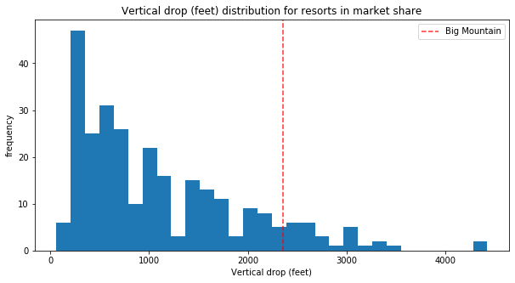
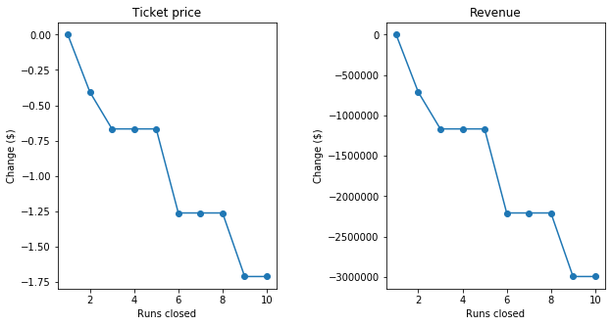
What does the data show?
After finding the best model and evaluating several options there are 2 options I can recommend.
First would be closing 1 run to cut maintenance costs:
Secondly we can increase vertical drop by adding 1 run and 1 chairlift:

Slide 7
In Summary
By adopting 1 or both of these recommendations Big Mountain Resort can achieve its goals of greater profit with the confidence of an approach backed by data

